Slide 1


Lecture 1
DLI
Combinatorial Analysis
组合分析

Slide 2
DLI
Outline
Introduction
The Basic Principle of Counting
Permutations
Combinations
Multinomial Coefficients

Slide 3
DLI
Introduction
The term probability refers to the study of randomness and uncertainty. In any situation in which one of a number of possible outcomes may occur, the discipline of probability provides methods for quantifying the chances, or likelihoods, associated with the various outcomes.

Slide 4
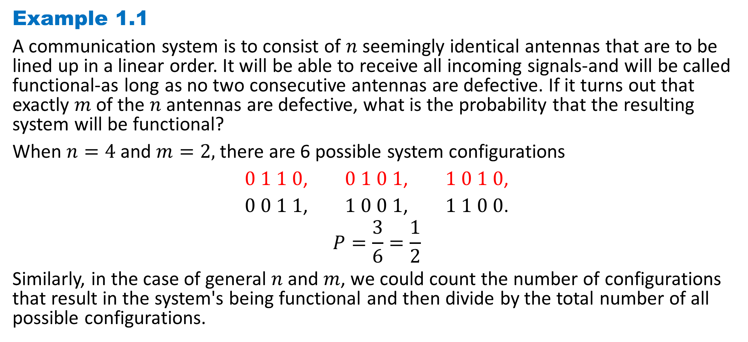
DLI
Example 1.1
A communication system is to consist of $n$ seemingly identical antennas that are to be lined up in a linear order. It will be able to receive all incoming signals-and will be called functional-as long as no two consecutive antennas are defective. If it turns out that exactly $m$ of the $n$ antennas are defective, what is the probability that the resulting system will be functional?
When $n=4$and $m=2,$ there are 6 possible system configurations
$0 1 1 0$, $0 1 0 1$, $1 0 1 0$,
$0 0 1 1$, $1 0 0 1$, $1 1 0 0$.
$$P=\frac{3}{6}=\frac{1}{2}$$
Similarly, in the case of general $n$ and $m$, we could count the number of configurations that result in the system's being functional and then divide by the total number of all possible configurations.

Slide 5
DLI
It would be useful to have an effective method for counting the number of ways that things can occur. In fact, many problems in probability theory can be solved simply by counting the number of different ways that a certain event can occur. The mathematical theory of counting is formally known as combinatorial analysis.

Slide 6
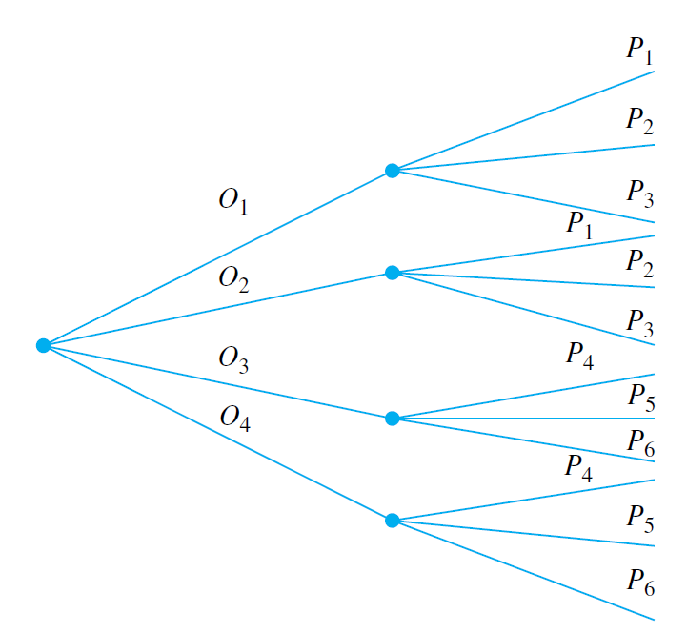
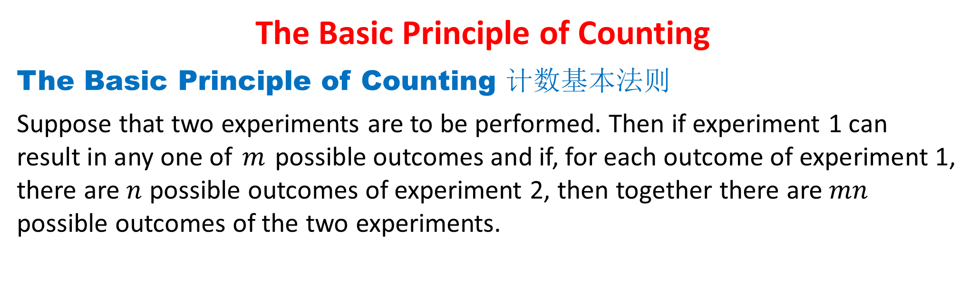
DLI
The Basic Principle of Counting
The Basic Principle of Counting 计数基本法则
Suppose that two experiments are to be performed. Then if experiment 1 can result in any one of $m$ possible outcomes and if, for each outcome of experiment 1, there are $n$ possible outcomes of experiment 2, then together there are $mn$ possible outcomes of the two experiments.

Slide 7

DLI
Example 1.2
A small community consists of 10 women, each of whom has 3 children. If one woman and one of her children are to be chosen as mother and child of the year, how many different choices are possible?
$$10×3=30$$

Slide 8
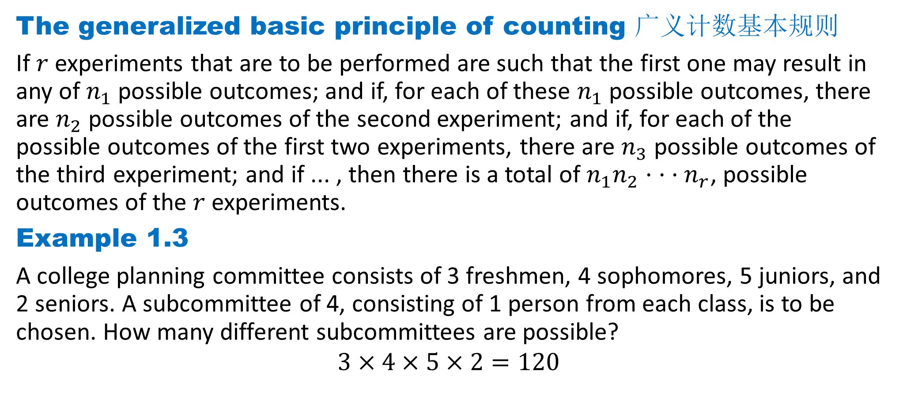
DLI
The generalized basic principle of counting 广义计数基本规则
If $r$ experiments that are to be performed are such that the first one may result in any of $n_{1}$ possible outcomes; and if, for each of these $n_{1}$ possible outcomes, there are $n_{2}$ possible outcomes of the second experiment; and if, for each of the possible outcomes of the first two experiments, there are $n_{3}$ possible outcomes of the third experiment; and if ... , then there is a total of $n_{1}n_{2}· · ·n_{r}$, possible outcomes of the $r$ experiments.
Example 1.3
A college planning committee consists of 3 freshmen, 4 sophomores, 5 juniors, and 2 seniors. A subcommittee of 4, consisting of 1 person from each class, is to be chosen. How many different subcommittees are possible?
$$3×4×5×2=120$$

Slide 9
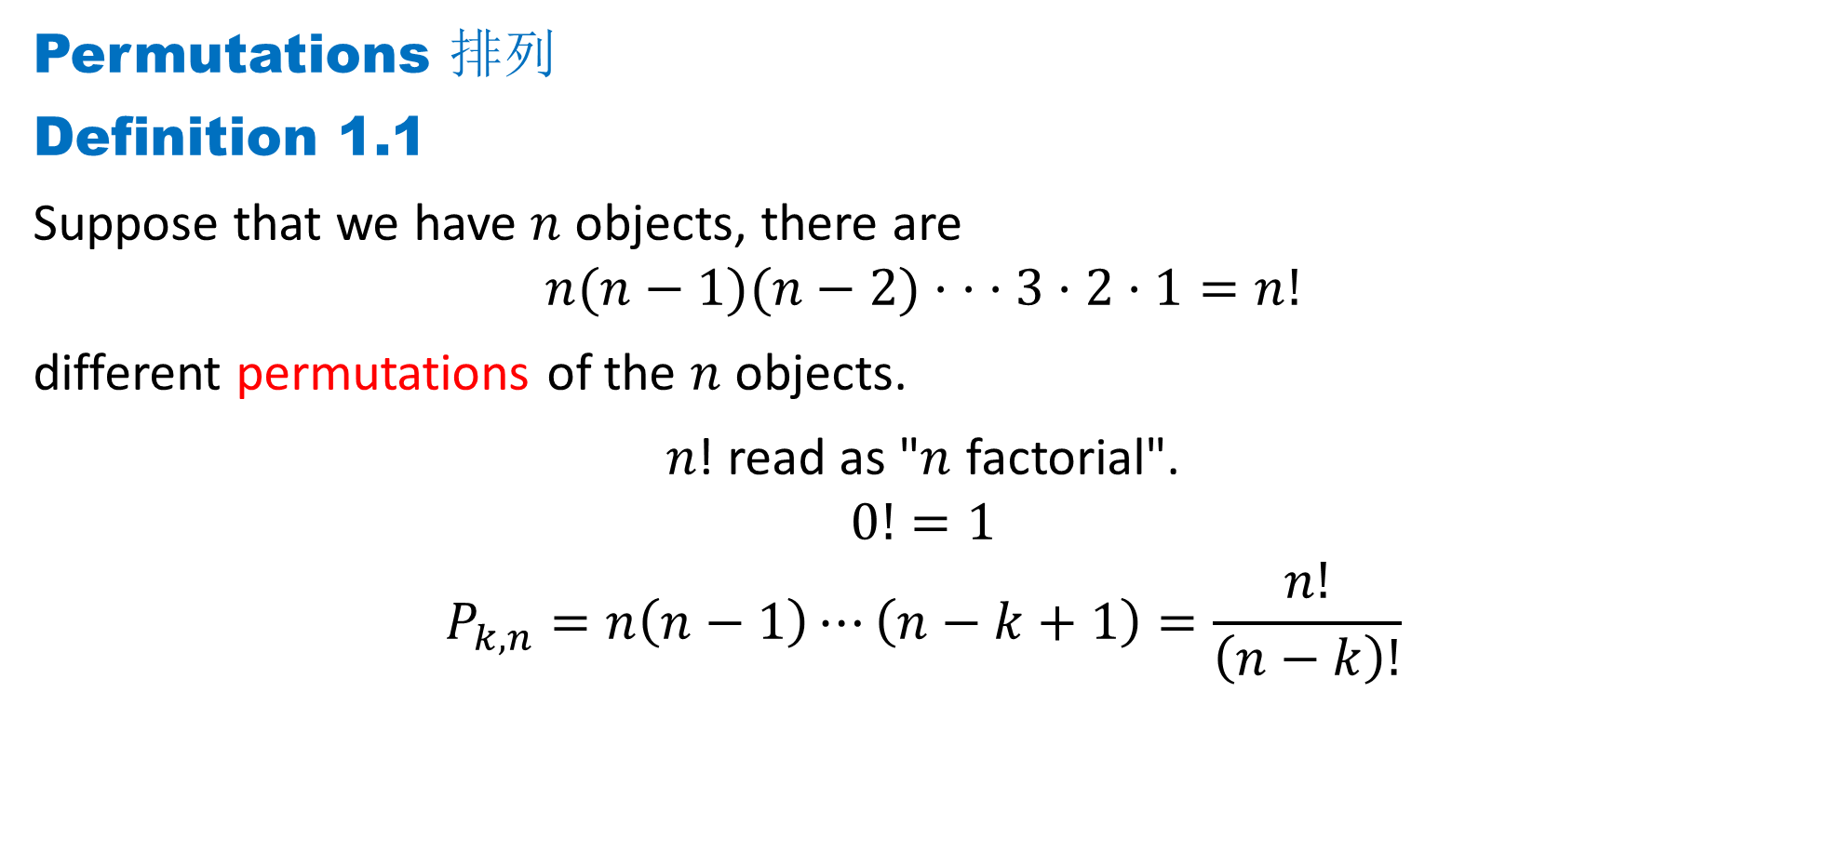
DLI
Permutations 排列
Definition 1.1
Suppose that we have $n$ objects, there are
$$n(n−1)(n−2)· · ·3·2·1=n!$$
different permutations of the $n$ objects.
𝑛! read as "$n$ factorial".
$$0!=1$$
$$P_{k,n}=n\left(n−1\right)⋯\left(n−k+1\right)=\frac{n!}{\left(n−k\right)!}$$

Slide 10
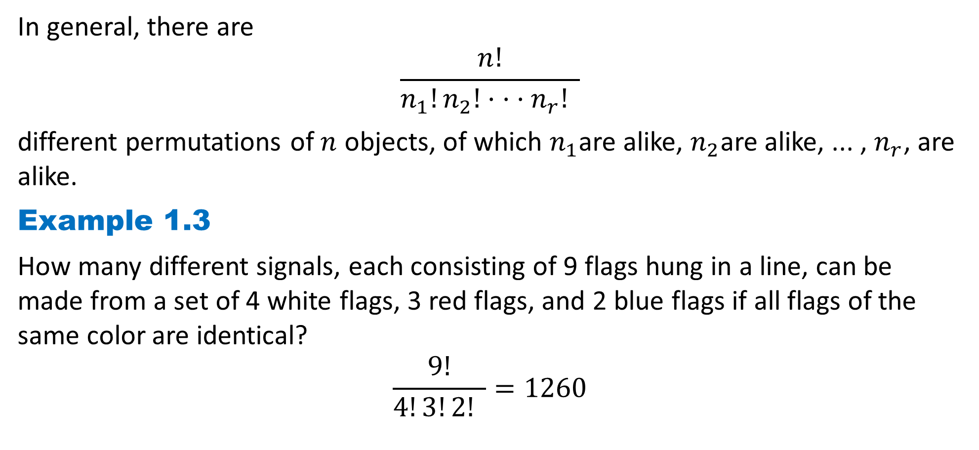
DLI
In general, there are
$$\frac{n!}{n_{1}!n_{2}!· · ·n_{r}! }$$
different permutations of $n$ objects, of which $n_{1}$are alike, $n_{2}$are alike, ... , $n_{r}$, are alike.
Example 1.3
How many different signals, each consisting of 9 flags hung in a line, can be made from a set of 4 white flags, 3 red flags, and 2 blue flags if all flags of the same color are identical?
$$\frac{9!}{4!3!2! }=1260$$

Slide 11
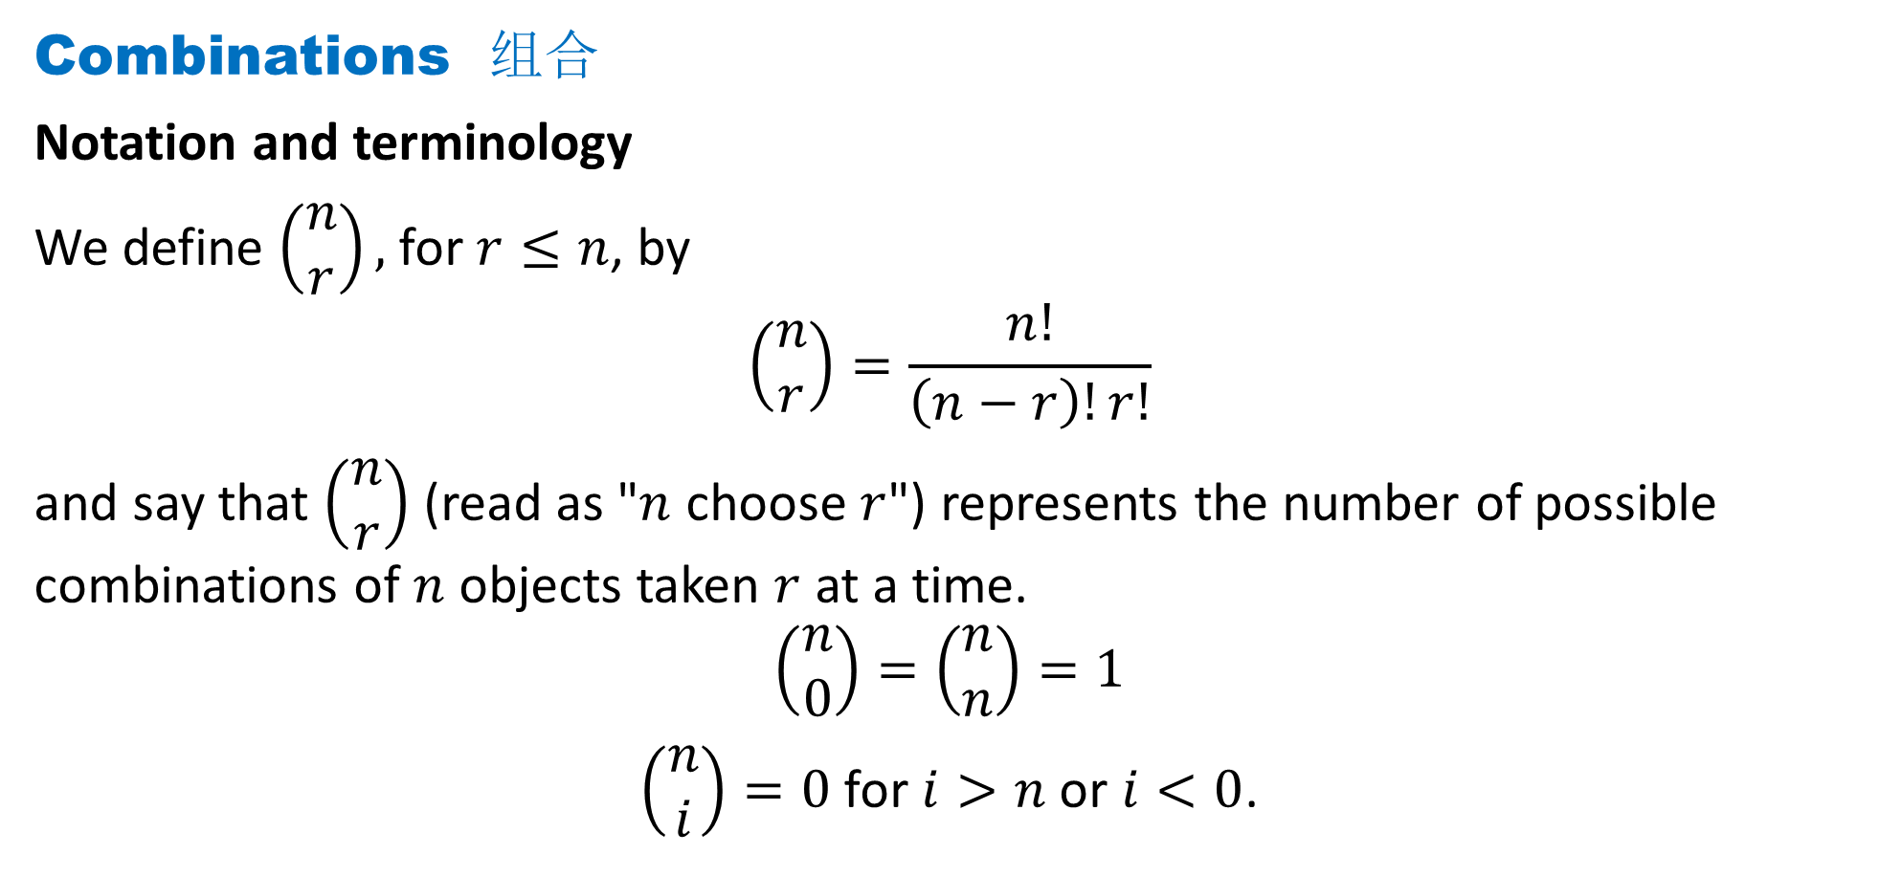
DLI
Combinations 组合
Notation and terminology
We define $\left(\begin{matrix}n \\ r\end{matrix}\right),$ for $r≤n$, by
$$\left(\begin{matrix}n \\ r\end{matrix}\right)=\frac{n!}{\left(n−r\right)!r!}$$
and say that $\left(\begin{matrix}n \\ r\end{matrix}\right)$(read as "$n$ choose $r$") represents the number of possible combinations of $n$ objects taken $r$ at a time.
$$\left(\begin{matrix}n \\ 0\end{matrix}\right)=\left(\begin{matrix}n \\ n\end{matrix}\right)=1$$
$\left(\begin{matrix}n \\ i\end{matrix}\right)=0$ for $i>n$ or $i<0$.

Slide 12
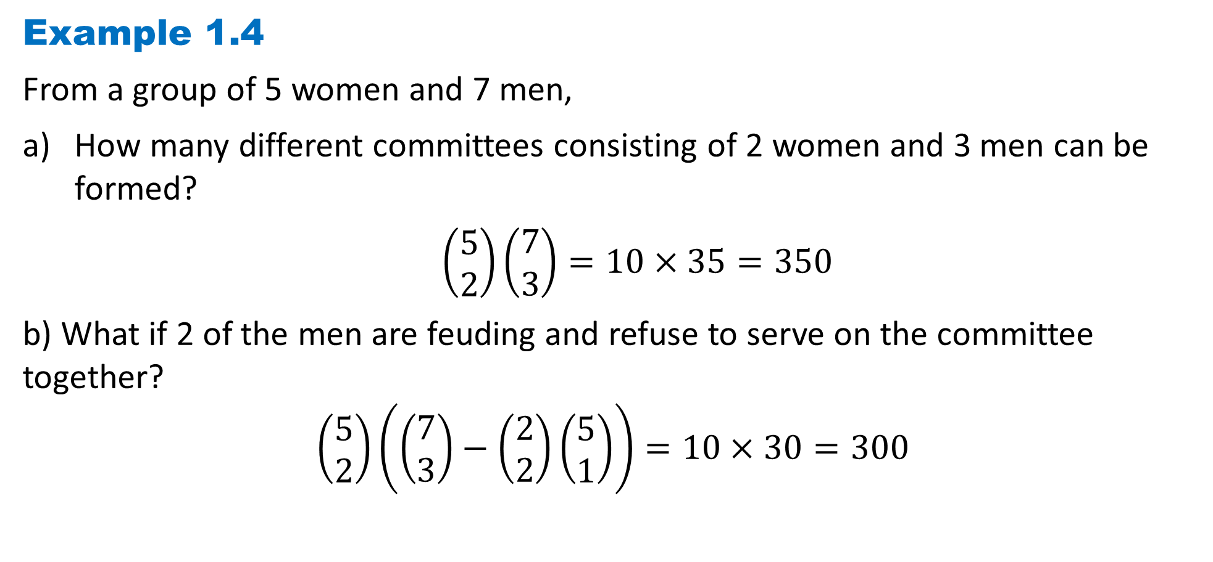
DLI
Example 1.4
From a group of 5 women and 7 men,
How many different committees consisting of 2 women and 3 men can be formed?
$\left(\begin{matrix}5 \\ 2\end{matrix}\right)\left(\begin{matrix}7 \\ 3\end{matrix}\right)=10×35=350$
b) What if 2 of the men are feuding and refuse to serve on the committee together?
$$\left(\begin{matrix}5 \\ 2\end{matrix}\right)\left(\left(\begin{matrix}7 \\ 3\end{matrix}\right)−\left(\begin{matrix}2 \\ 2\end{matrix}\right)\left(\begin{matrix}5 \\ 1\end{matrix}\right)\right)=10×30=300$$

Slide 13
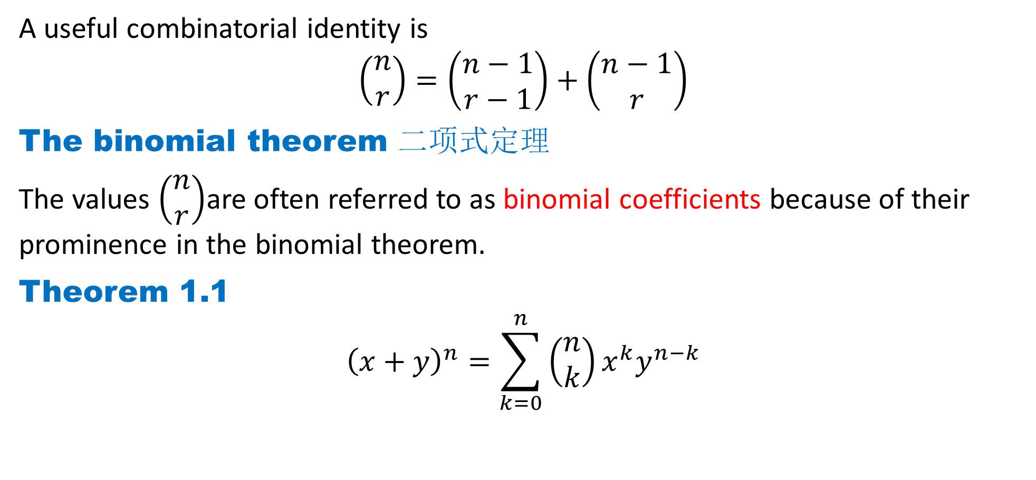
DLI
A useful combinatorial identity is
$$\left(\begin{matrix}n \\ r\end{matrix}\right)=\left(\begin{matrix}n−1 \\ r−1\end{matrix}\right)+\left(\begin{matrix}n−1 \\ r\end{matrix}\right)$$
The binomial theorem 二项式定理
The values $\left(\begin{matrix}n \\ r\end{matrix}\right)$are often referred to as binomial coefficients because of their prominence in the binomial theorem.
Theorem 1.1
$${\left(x+y\right)}^{n}=\sum_{k=0}^{n}{\left(\begin{matrix}n \\ k\end{matrix}\right)}x^{k}y^{n−k}$$

Slide 14
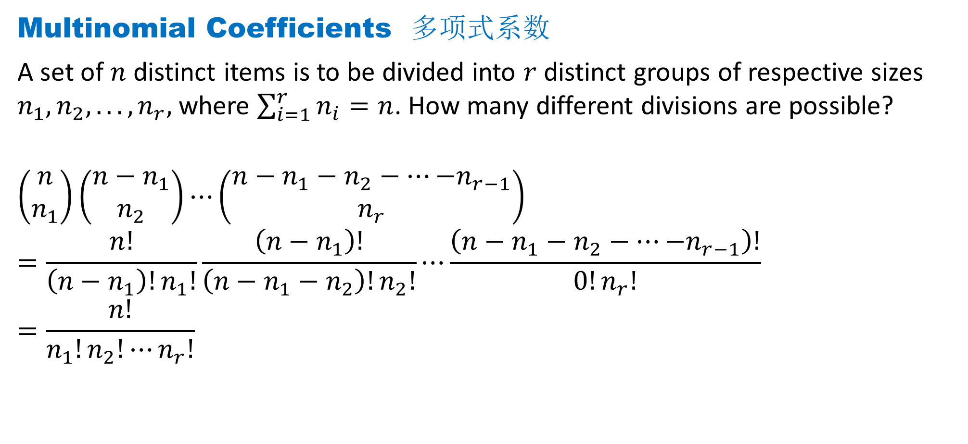
DLI
Multinomial Coefficients 多项式系数
A set of $n$ distinct items is to be divided into $r$ distinct groups of respective sizes $n_{1}, n_{2}, . .. , n_{r},$ where $\sum_{i=1}^{r}{n_{i}}=n$. How many different divisions are possible?
$$\left(\begin{matrix}n \\ n_{1}\end{matrix}\right)\left(\begin{matrix}n−n_{1} \\ n_{2}\end{matrix}\right)⋯\left(\begin{matrix}n−n_{1}−n_{2}−⋯{−n}_{r−1} \\ n_{r}\end{matrix}\right)$$
$$=\frac{n!}{\left(n−n_{1}\right)!n_{1}!}\frac{\left(n−n_{1}\right)!}{\left(n−n_{1}−n_{2}\right)!n_{2}!}⋯\frac{\left(n−n_{1}−n_{2}−⋯{−n}_{r−1}\right)!}{0!n_{r}!}$$
$$=\frac{n!}{n_{1}!n_{2}!⋯n_{r}!}$$

Slide 15
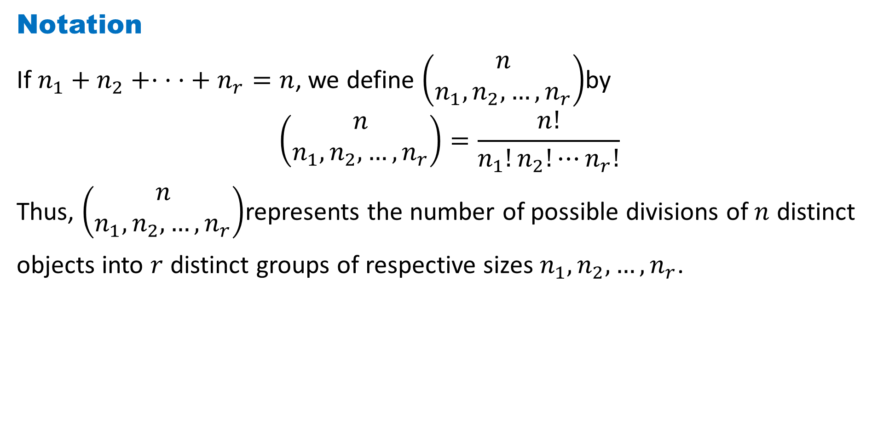
DLI
Notation
If $n_{1}+n_{2}+· · ·+ n_{r}=n$, we define $\left(\begin{matrix}n \\ n_{1},n_{2},…,n_{r}\end{matrix}\right)$by
$$\left(\begin{matrix}n \\ n_{1},n_{2},…,n_{r}\end{matrix}\right)=\frac{n!}{n_{1}!n_{2}!⋯n_{r}!}$$
Thus, $\left(\begin{matrix}n \\ n_{1},n_{2},…,n_{r}\end{matrix}\right)$represents the number of possible divisions of $n$ distinct
objects into $r$ distinct groups of respective sizes $n_{1},n_{2},…,n_{r}$.

Slide 16
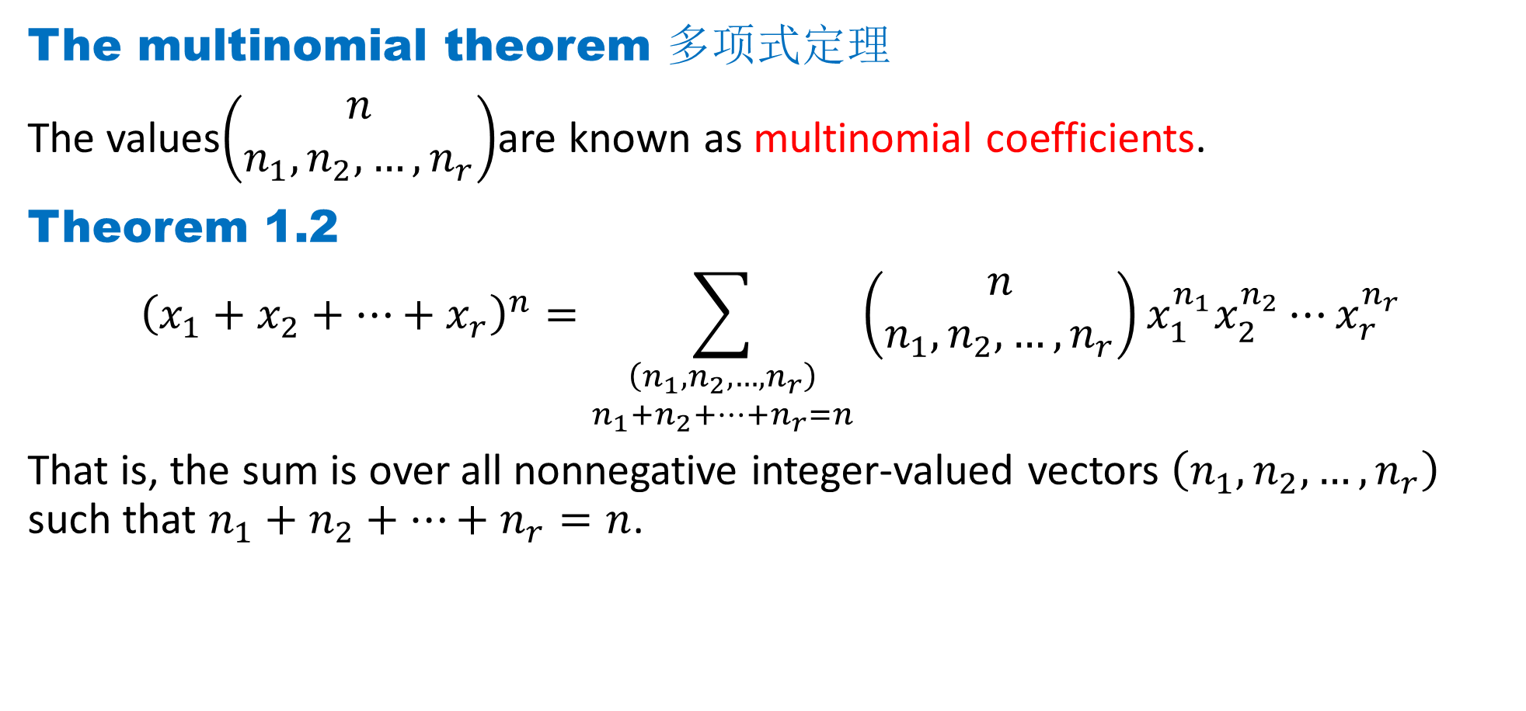
DLI
The multinomial theorem 多项式定理
The values$\left(\begin{matrix}n \\ n_{1},n_{2},…,n_{r}\end{matrix}\right)$are known as multinomial coefficients.
Theorem 1.2
$${\left(x_{1}+x_{2}+⋯+x_{r}\right)}^{n}=\sum_{\begin{matrix}\left(n_{1},n_{2},…,n_{r}\right) \\ {n_{1}+n}_{2}+…+n_{r}=n\end{matrix}}{\left(\begin{matrix}n \\ n_{1},n_{2},…,n_{r}\end{matrix}\right)x_{1}^{n_{1}}x_{2}^{n_{2}}⋯x_{r}^{n_{r}}}$$
That is, the sum is over all nonnegative integer-valued vectors $\left(n_{1},n_{2},…,n_{r}\right)$ such that ${n_{1}+n}_{2}+…+n_{r}=n$.

Slide 17
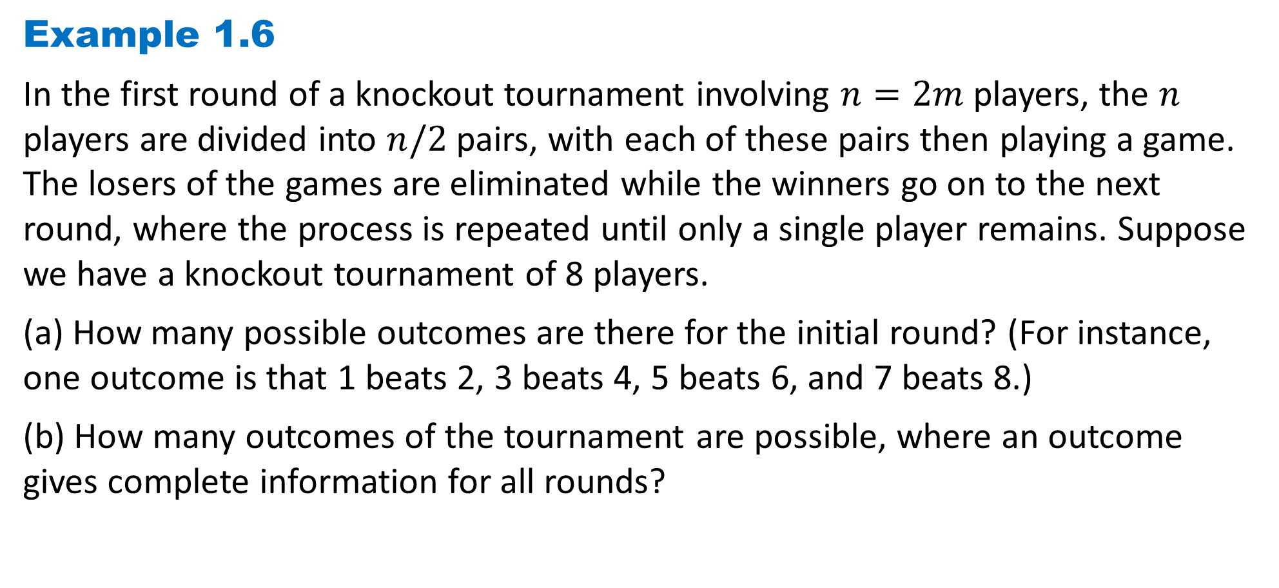
DLI
Example 1.6
In the first round of a knockout tournament involving $n=2m$players, the $n$ players are divided into $n/2$pairs, with each of these pairs then playing a game. The losers of the games are eliminated while the winners go on to the next round, where the process is repeated until only a single player remains. Suppose we have a knockout tournament of 8 players.
(a) How many possible outcomes are there for the initial round? (For instance, one outcome is that 1 beats 2, 3 beats 4, 5 beats 6, and 7 beats 8.)
(b) How many outcomes of the tournament are possible, where an outcome gives complete information for all rounds?

Slide 18
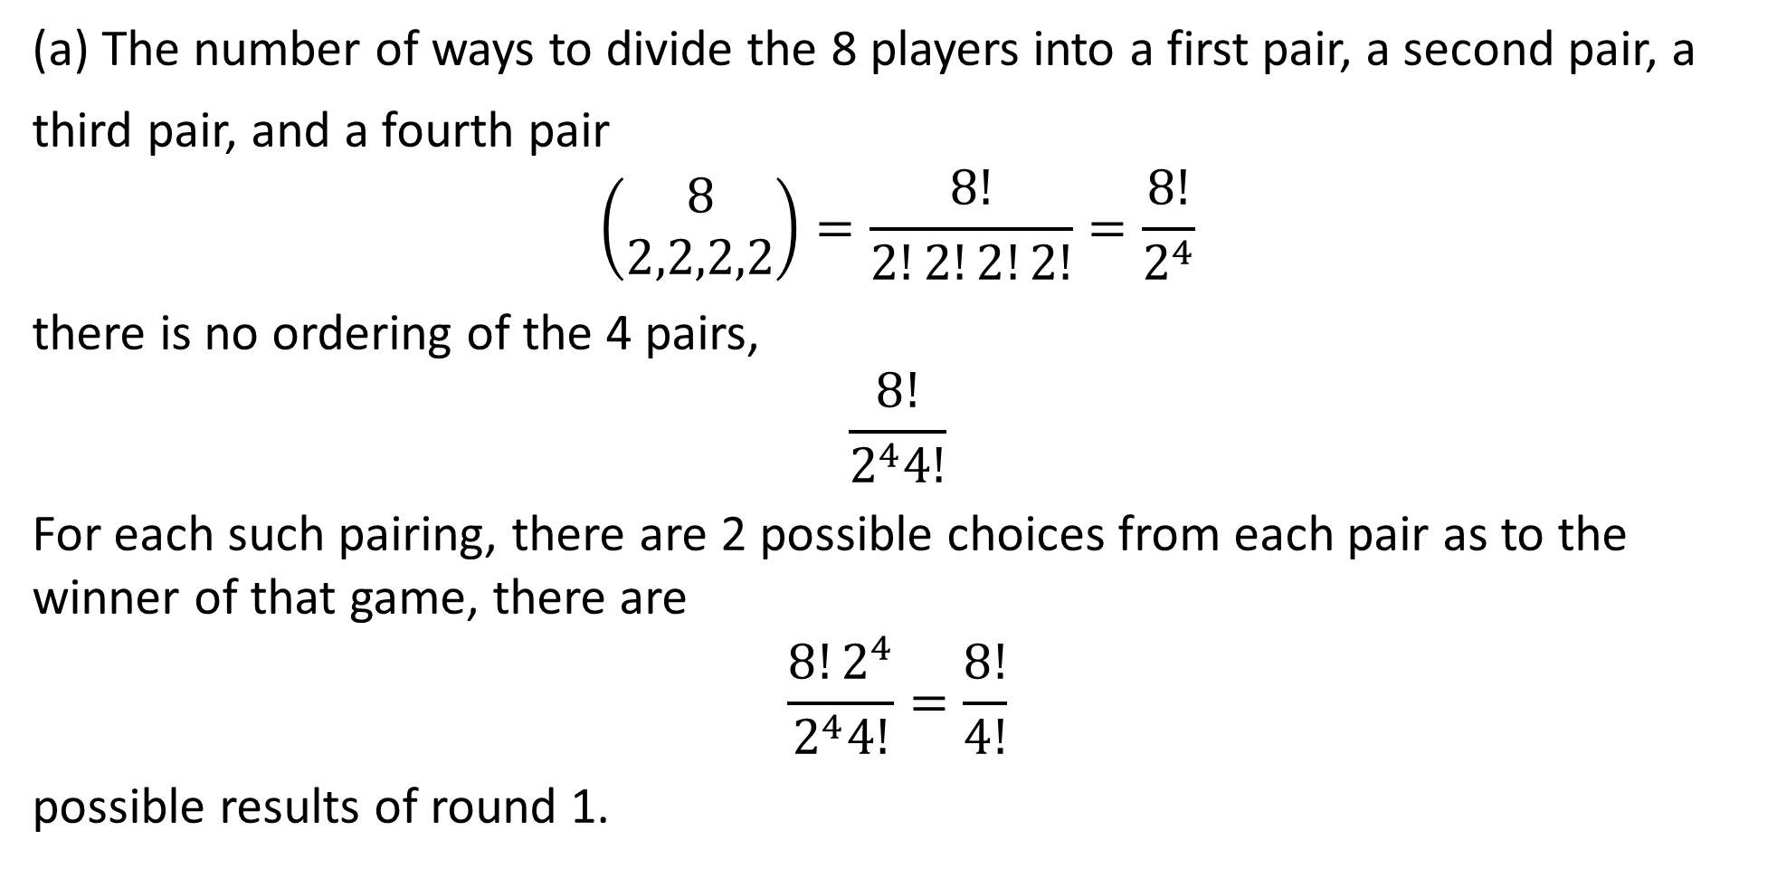
DLI
(a) The number of ways to divide the 8 players into a first pair, a second pair, a
third pair, and a fourth pair
$$\left(\begin{matrix}8 \\ 2,2,2,2\end{matrix}\right)=\frac{8!}{2!2!2!2!}=\frac{8!}{2^{4}}$$
there is no ordering of the 4 pairs,
$$\frac{8!}{2^{4}4!}$$
For each such pairing, there are 2 possible choices from each pair as to the winner of that game, there are
$$\frac{8!2^{4}}{2^{4}4!}=\frac{8!}{4!}$$
possible results of round 1.

Slide 19
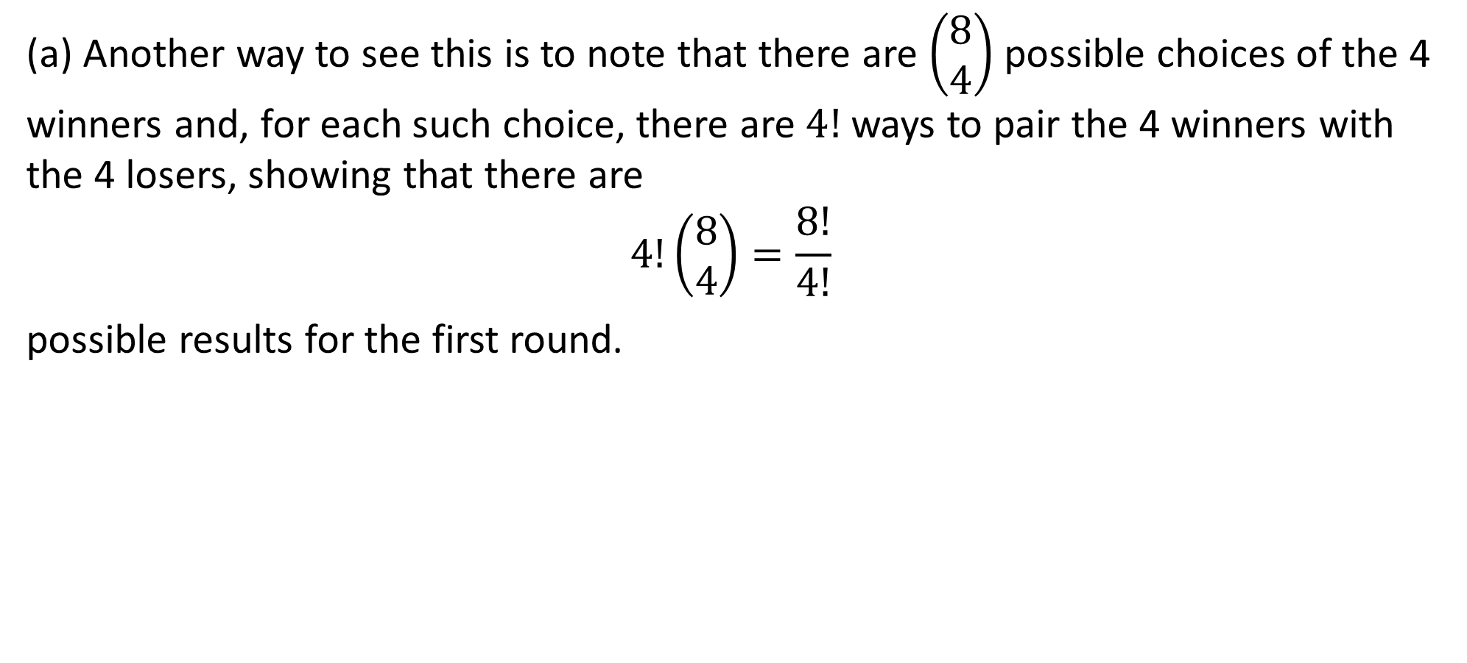
DLI
(a) Another way to see this is to note that there are $\left(\begin{matrix}8 \\ 4\end{matrix}\right)$ possible choices of the 4 winners and, for each such choice, there are $4!$ ways to pair the 4 winners with the 4 losers, showing that there are
$$4!\left(\begin{matrix}8 \\ 4\end{matrix}\right)=\frac{8!}{4!}$$
possible results for the first round.

Slide 20
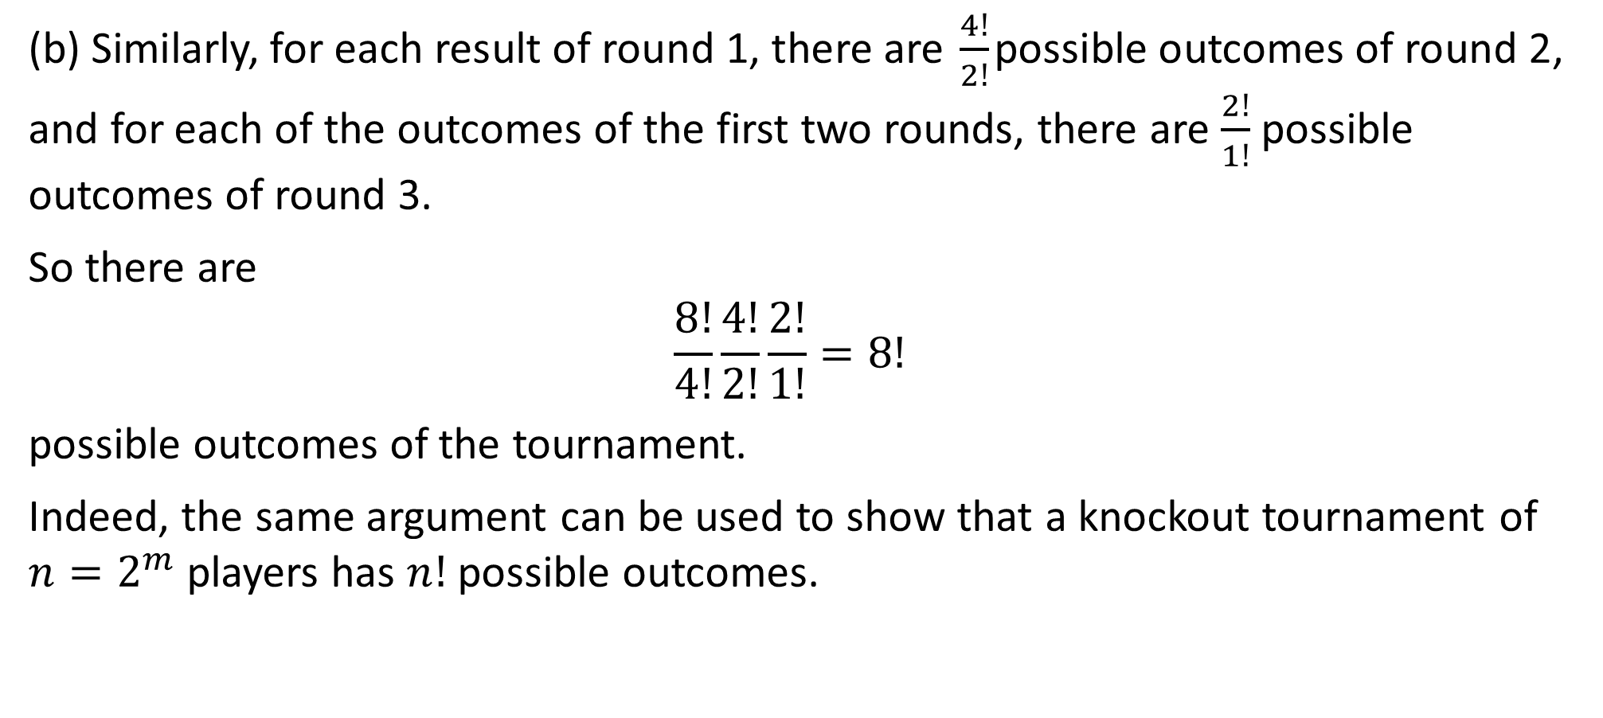
DLI
(b) Similarly, for each result of round 1, there are $\frac{4!}{2!}$possible outcomes of round 2, and for each of the outcomes of the first two rounds, there are $\frac{2!}{1!}$ possible outcomes of round 3.
So there are
$$\frac{8!}{4!}\frac{4!}{2!}\frac{2!}{1!}=8!$$
possible outcomes of the tournament.
Indeed, the same argument can be used to show that a knockout tournament of $n=2^{m}$players has $n!$ possible outcomes.

Slide 21
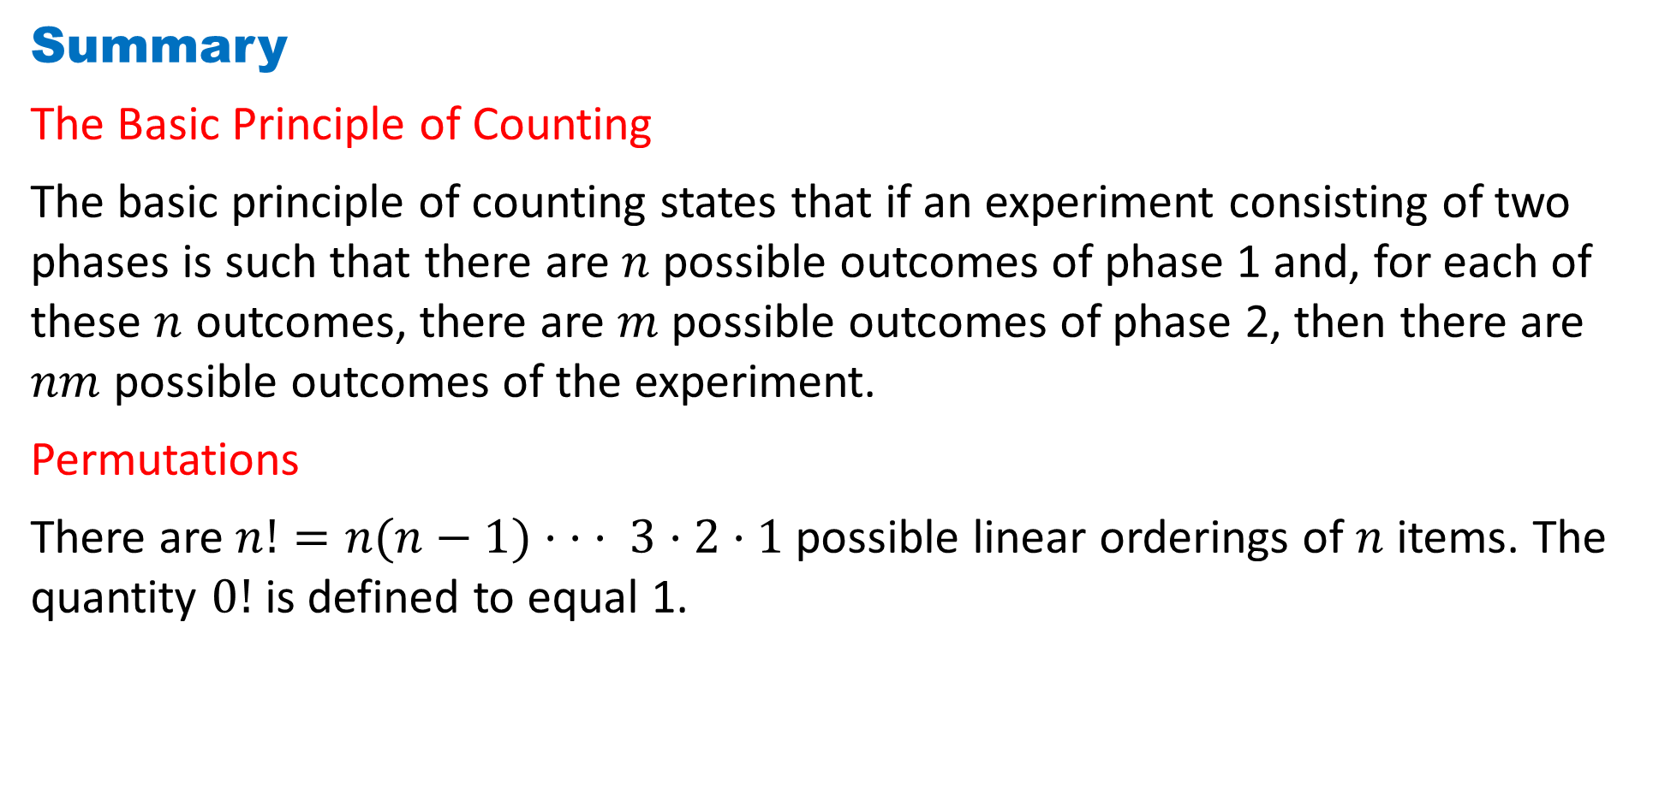
DLI
Summary
The Basic Principle of Counting
The basic principle of counting states that if an experiment consisting of two phases is such that there are $n$ possible outcomes of phase 1 and, for each of these $n$ outcomes, there are $m$ possible outcomes of phase 2, then there are $nm$ possible outcomes of the experiment.
Permutations
There are $n!=n(n−1)· · · 3·2·1$possible linear orderings of $n$ items. The quantity $0!$ is defined to equal 1.

Slide 22
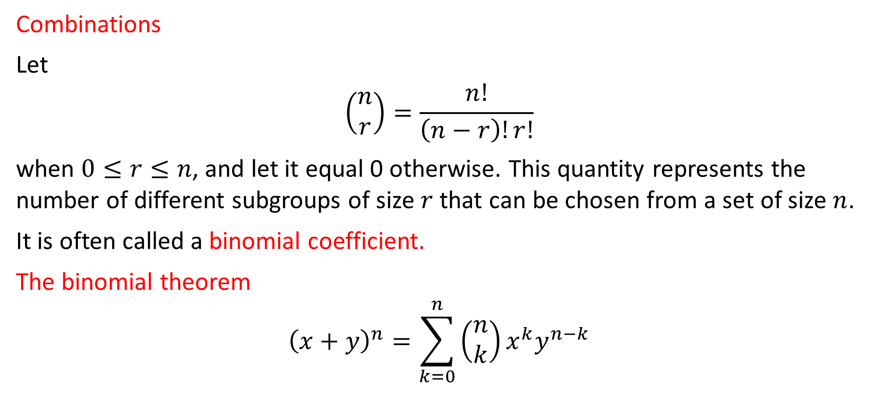
DLI
Combinations
Let
$$\left(\begin{matrix}n \\ r\end{matrix}\right)=\frac{n!}{\left(n−r\right)!r!}$$
when $0≤r≤n$, and let it equal 0 otherwise. This quantity represents the number of different subgroups of size $r$ that can be chosen from a set of size $n$.
It is often called a binomial coefficient.
The binomial theorem
$${\left(x+y\right)}^{n}=\sum_{k=0}^{n}{\left(\begin{matrix}n \\ k\end{matrix}\right)}x^{k}y^{n−k}$$

Slide 23
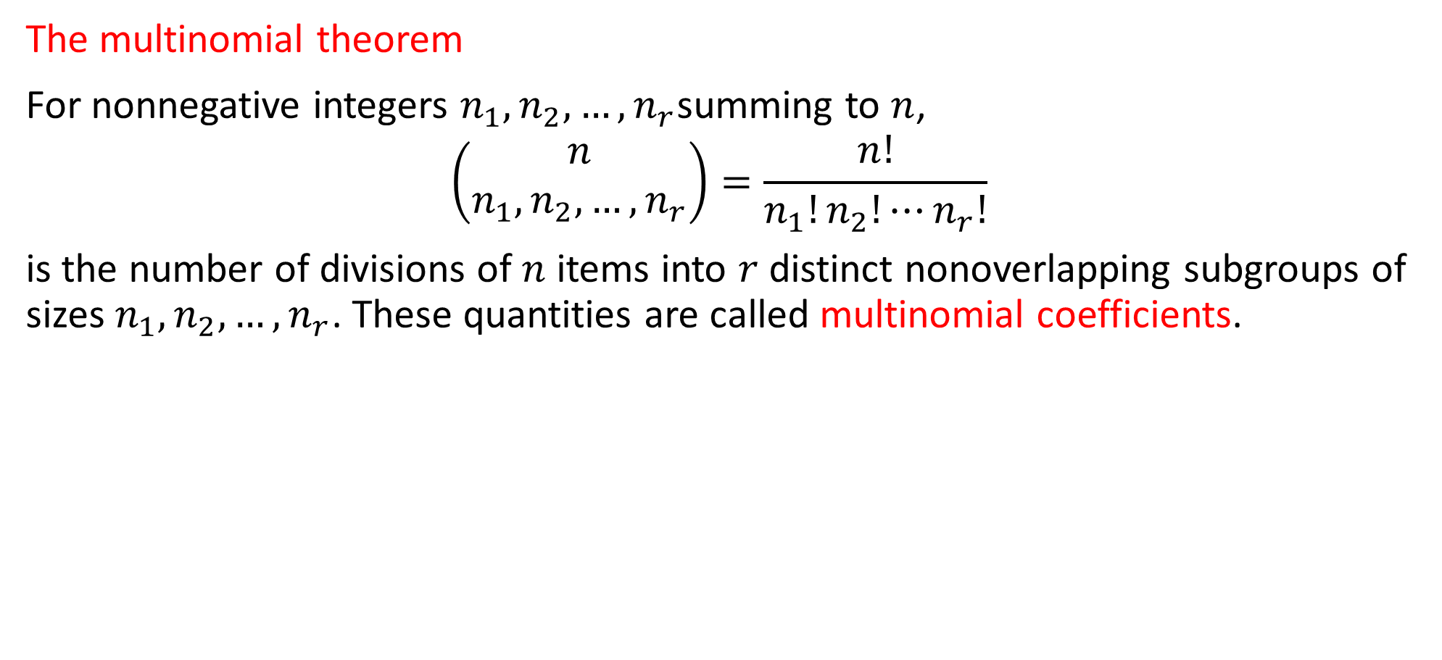
DLI
The multinomial theorem
For nonnegative integers $n_{1},n_{2},…,n_{r}$summing to $n$,
$$\left(\begin{matrix}n \\ n_{1},n_{2},…,n_{r}\end{matrix}\right)=\frac{n!}{n_{1}!n_{2}!⋯n_{r}!}$$
is the number of divisions of $n$ items into $r$distinct nonoverlapping subgroups of sizes $n_{1},n_{2},…,n_{r}$. These quantities are called multinomial coefficients.

Slide 24
DLI
Homework
Page 15 Problems
2, 7, 8, 13
Page 17 Theoretical Exercises
8, 13
Page 19 Self-Test Problems and Exercises
4, 12

